Slide 1
Toegepaste Micro-economie: Public economics
Dr. Josse Delfgaauw
delfgaauw@ese.eur.nl
Week 4:
Redistribution

Slide 2
4. Redistribution and social security
Background and some figures
Why redistribution?
Why government involvement in redistribution?
Efficiency effects of redistribution

Slide 3
Redistribution and social security
Redistribution:
Altering the distribution of a good (e.g. income) over individuals (or households)
In history:
Redistribution towards the King / Emperor / Pharao
Nowadays, redistribution policies aim to transfer resources from the rich to the poor
Many other policy measures also redistribute, sometimes from poor to rich, or from young to old, singles to households, etc.

Slide 4
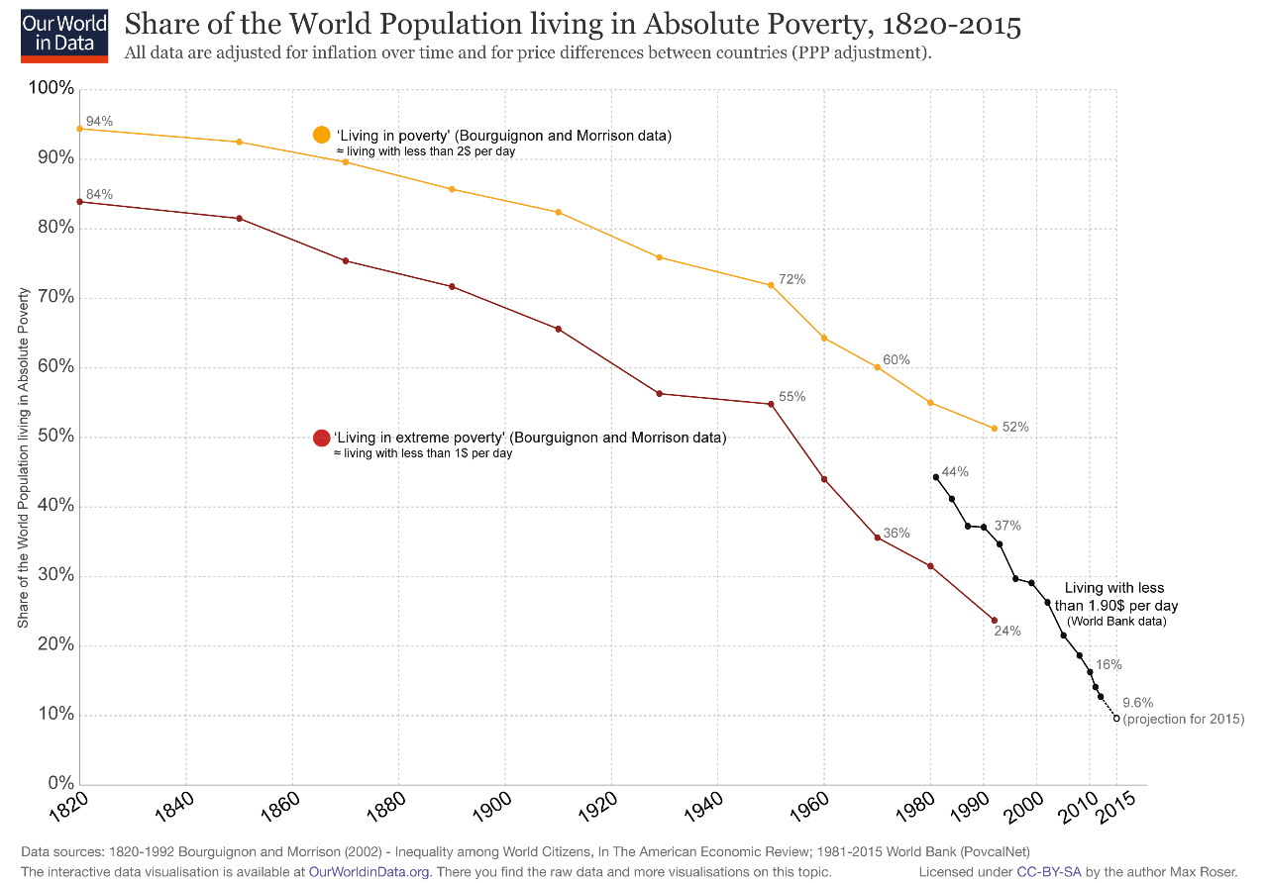
Redistribution and social security
Global perspective: # people in extreme poverty
Source: ourworldindata.org

Slide 5
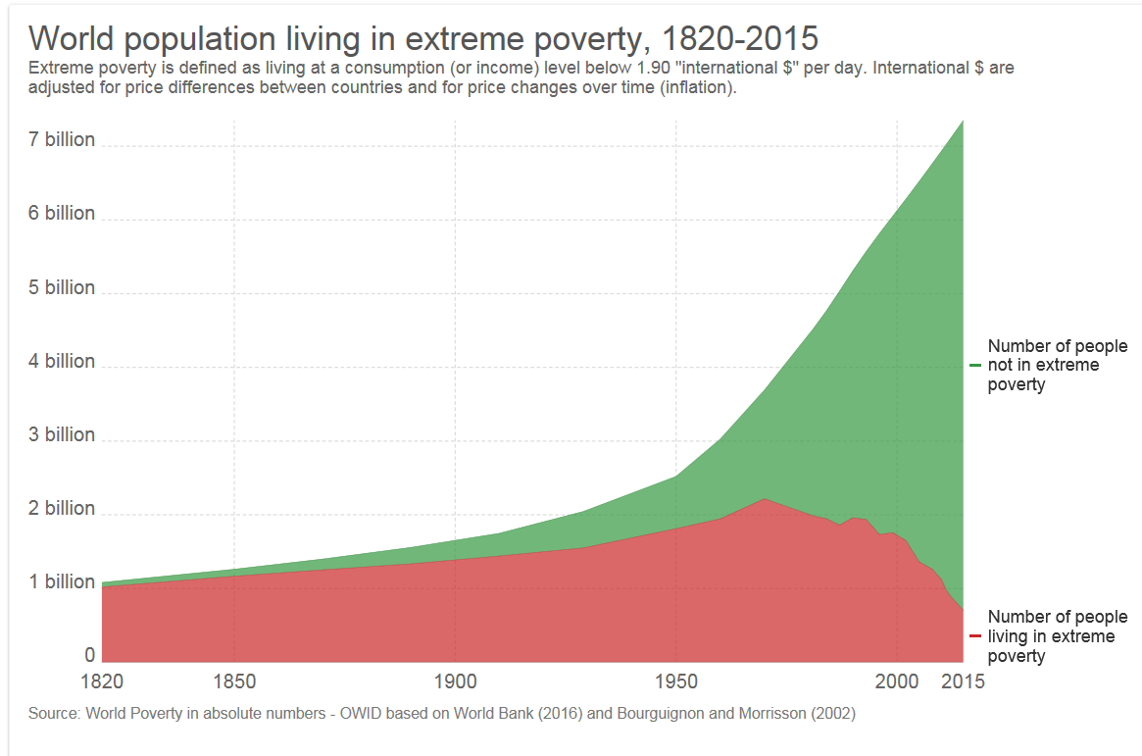
Redistribution and social security
Global perspective: # people in extreme poverty
Source: ourworldindata.org

Slide 6
Redistribution and social security
Unprecedented increase in living conditions in the past 200 years.
GDP per capita England
Importantly, this is not just about money:
Life expectancy
Infant mortality , by country , recent developments
Literacy
Child labour
But still a long way to go:
- Poverty rates
Source: ourworldindata.org

Slide 7
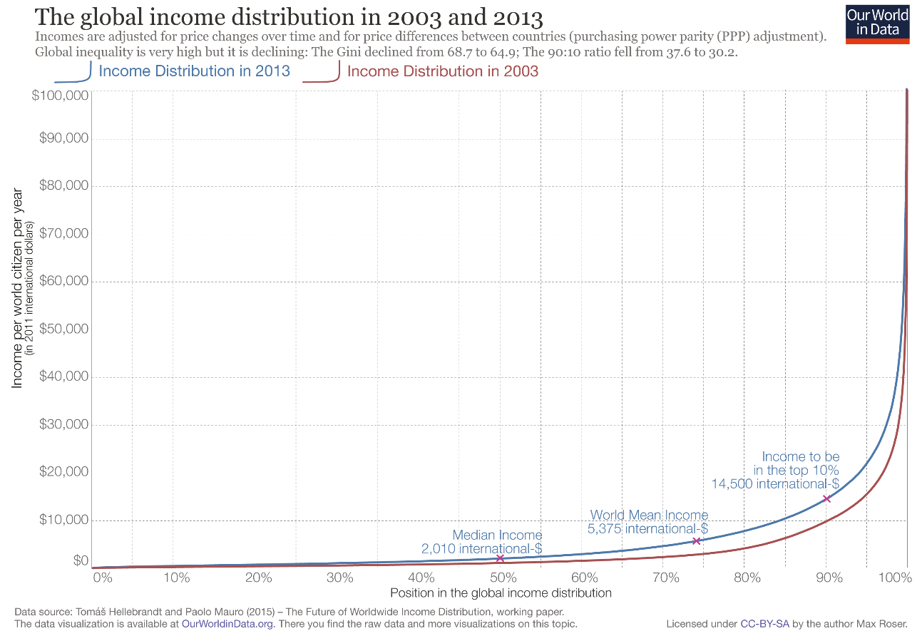
Redistribution and social security
Global perspective:
global income inequality is declining …
… but is still huge: (Source: ourworldindata.org)

Slide 8
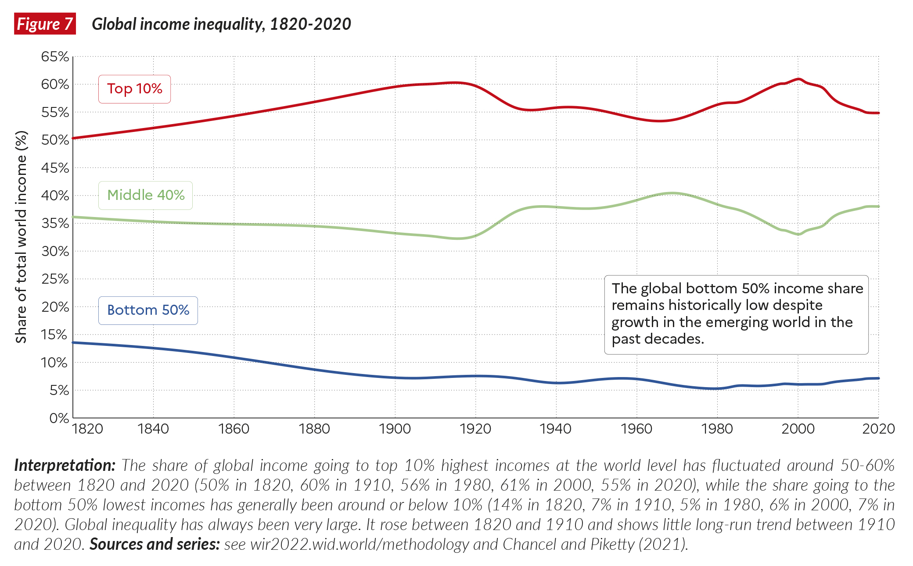
Redistribution and social security
Global perspective:
... And the global wealth distribution is even more unequal…
(source: world inequality report 2022)

Slide 9
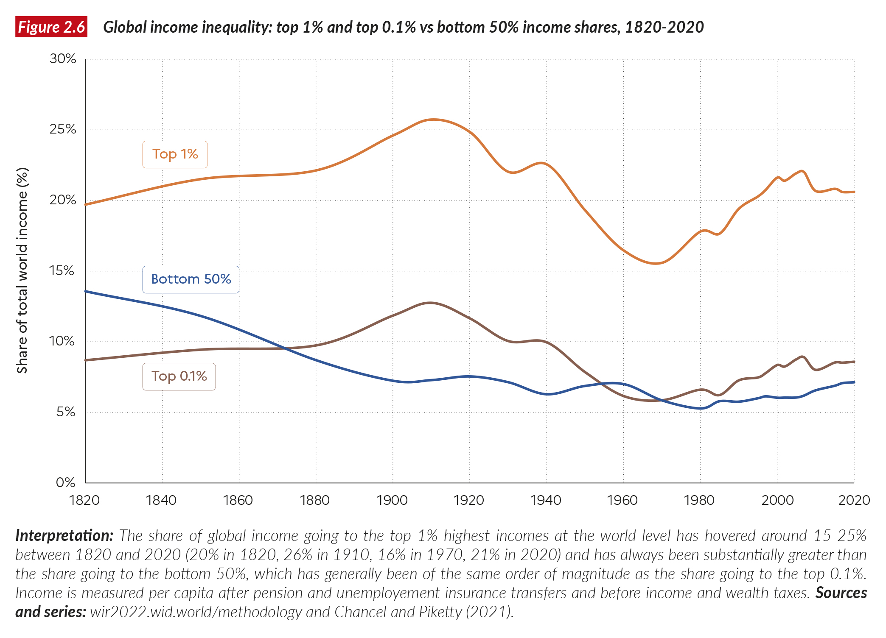
Redistribution and social security
… with a growing share for the most-wealthy 0.1%
(source: world inequality report 2022)

Slide 10
Redistribution and social security
Issues in data on income / wealth distribution:
  Unit of observation: Individuals or households?
  Before and after taxes, contributions, and benefits
  In-kind versus cash benefits: Many benefits from the government are not in cash, but in goods / services
  (see slide on ‘profijt van de overheid’)
  Data on wealth less reliable / complete than income data
Next slides: data for NL (from CBS and SCP)
  ‘gross income’ (market and benefits) and ‘disposable income’ (after taxes and contributions) to 10%-group;
  Inkind benefits to 10% income groups
  ‘Pen parade’ of income and wealth

Slide 11
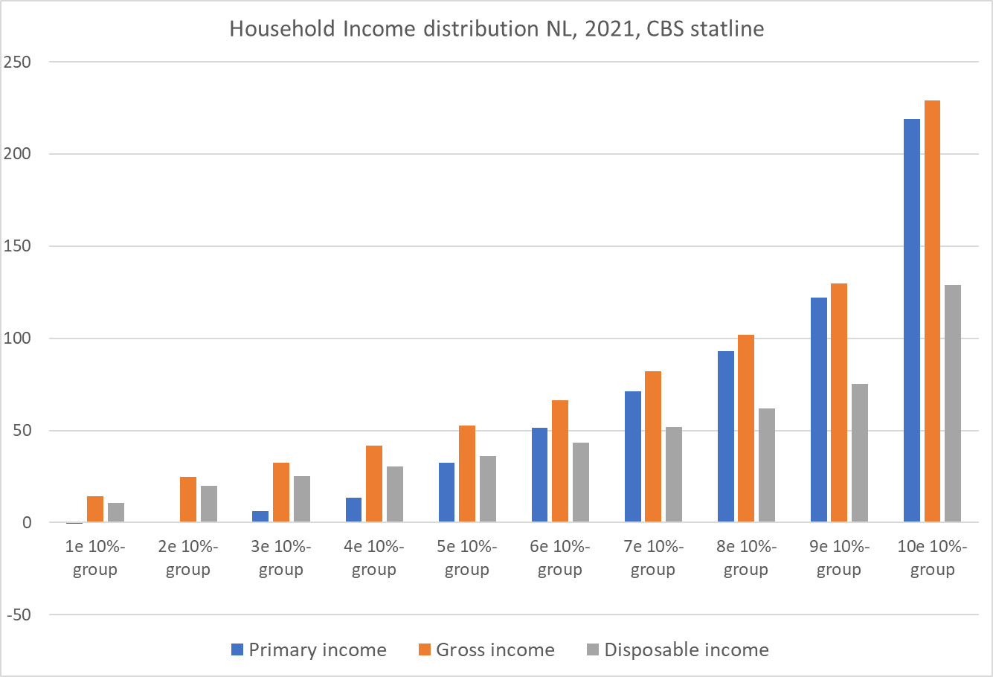
Income
(1,000s euro)

Slide 12
‘Profijt van de overheid’

Slide 13
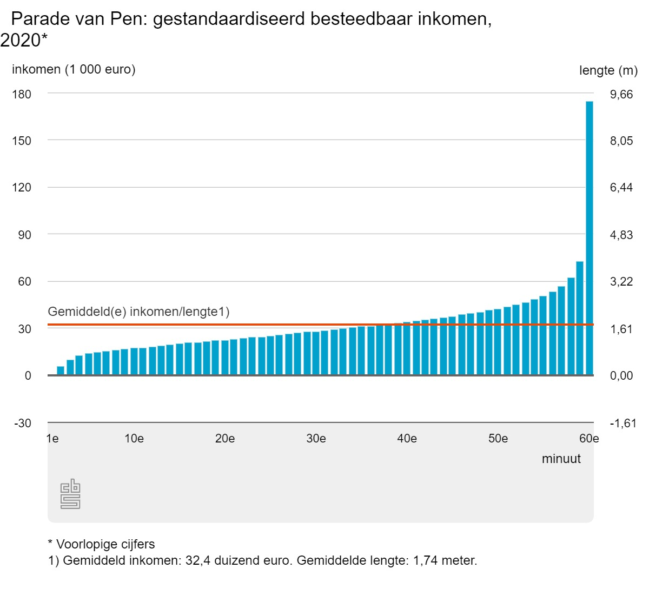
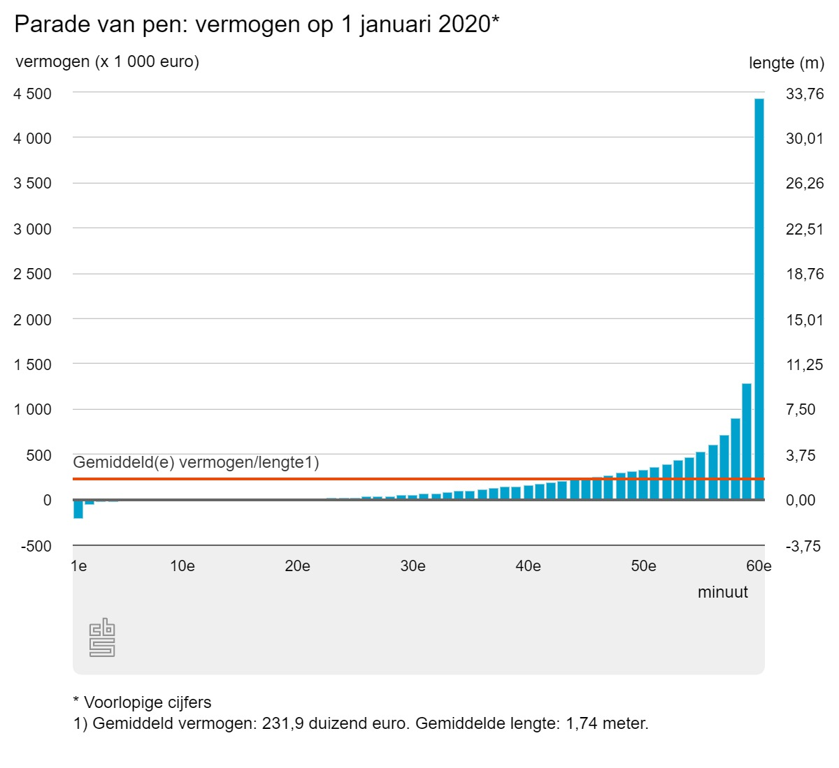
Income, NL
wealth, NL

Slide 14
Redistribution and social security
Historical developments over time (NL):
  Increasing and later decreasing government expenditures
  Same holds for social security expenditures:
    As % of GDP: 11.6% in ‘63; 20% in ‘83; 10,7% in ’00; 12% in ‘23
  Ratio’s:
    (inactive/active)*100: 42 in ’70; 80 in ’84; 58 in ’08; 71 in ’15; 66 in ‘23
    Old-age dependency ratio (= [ # 65+] / [#15-65]):
    From 0.24 in 2000 to 0.35 in 2020
Driving forces:
  Volume: number of programs + eligibility
  Price: inflation correction / link to income growth

Slide 15
Pub spending on unemployment, sickness & disability insurance 2015, as % GDP
Source: OECD

Slide 16
Pub spending on pensions, as % GDP
Source: OECD

Slide 17
0
Why Redistribution?
Note:
Fully self-interested rich individuals prefer no redistribution
Normative answer:
Because ‘society’ prefers a different distribution than the market generates
Using Utilitarian Social Welfare Function:
W = F(U₁, U₂, ,,,, U_{n}) ,
Redistribution aims to
“Promote Greatest Good for Greatest Number”
(Bentham)
Notes:
Review General Concept of Social Welfare Function
Utilitarianism simply means W a function of people’s utility
Conventional Welfare Economics posits W = F(U1, U2, …, Un), but this so general it doesn’t tell us much
Utilitarians believed in additive welfare function, although W = F( ) is called a utilitarian welfare function

Slide 18
0
Why Redistribution?
Recall from ch. 3: Second Fundamental Theorem
Any Pareto-efficient allocation of goods (and, hence, utility) can be obtained through reallocation of resources
Example: redistribution with additive SW function:
W = U₁ + U₂ + … + U_{n}
Assume:
Utility of individuals depends only on their income
Utility functions exhibit diminishing marginal utility of income: U’> 0 and U’’< 0
Total amount of income is fixed
Optimal distribution has: MU₁(I₁) = MU₂(I₂) = MU_{n}(I_{n})
Notes:
Review General Concept of Social Welfare Function
Utilitarianism simply means W a function of people’s utility
Conventional Welfare Economics posits W = F(U1, U2, …, Un), but this so general it doesn’t tell us much
Utilitarians believed in additive welfare function, although W = F( ) is called a utilitarian welfare function

Slide 19
0
Optimal Redistribution
This is the net gain to society
Paul gains this much utility
Paul’s marginal utility
Peter’s marginal utility
e
f
Peter loses this much utility
d
c
MU_{Peter}
Take ab from Peter and give to Paul
Social welfare maximized
Paul’s income
MU_{Paul}
Peter’s income
0
0’
a
b
I*
Paul’s income
Peter’s income

Slide 20
0
Optimal Redistribution
If (and only if) you add the assumption
  Individuals have identical utility function
Then optimal distribution is complete equality
If U₁(I) = U₂(I) for all I, and U’’< 0, then
MU₁(I₁) = MU₂(I₂) if and only if I₁ = I₂
(Note: mathematically, MU₁(I₁) = MU₂(I₂) is the result of maximisation of W under constraint I₁ + I₂ = Fixed
→ Lagrange! )
See Exercise set 4
Notes:
Review General Concept of Social Welfare Function
Utilitarianism simply means W a function of people’s utility
Conventional Welfare Economics posits W = F(U1, U2, …, Un), but this so general it doesn’t tell us much
Utilitarians believed in additive welfare function, although W = F( ) is called a utilitarian welfare function

Slide 21
Optimal Redistribution
In general:
Shape of SW-function determines optimal redistribution
Much room for disagreement (What is ‘just’ or ‘fair’?)
Other theories of distributive justice, including
Rawls (minimax and ‘veil of ignorance’):
W = MIN (U₁, U₂, ,,,, U_{n})
Egalitarianism
Capabilities approach (Sen)
Libertarianism
…

Slide 22
Optimal Redistribution
Complications:
What if people differ in preferences (for instance relative preferences between income and leisure)?
Differences in outcomes due to (good vs bad) luck should be reduced.
But: what about differences in outcomes due to:
  Differences in effort?
  Differences in (innate) ability?
  Differences in birthplace?
  Differences in parental income / wealth (e.g. inheritances)?
Relative importance of ability, choices (incl. effort), and luck in determining outcomes?

Slide 23
Why Government Involvement?
Why is most redistribution done by the government?
Note: there is private redistribution!
  Charities; (Religious) communities; Families
Reason for private redistribution: Altruism
U₁ = F[I₁ , U₂(I₂)]
Pareto-efficient redistribution
(better term would be: “Pareto-improving redistribution”)
See exercise set 4

Slide 24
Why Government Involvement?
Why is most redistribution done by the government?
To answer: use framework of previous weeks
Is there market failure on the ‘market for redistribution’?
Welfare state as a public good
  Rich also benefit from alleviating poverty, but large free-rider problem (see exercise 4.4)
  Government enforces contributions
  Scale effects: defining who is poor; administration

Slide 25
Why Government Involvement?
Externalities of poverty
  Effect of poverty on well-being of others
  Spill-over effects
Incomplete information (?)
  People may be too positive about risk of becoming poor
  → Paternalism

Slide 26
Why Government Involvement?
Redistribution as poverty insurance
  Market failure due to asymmetric info: Large moral hazard and adverse selection problems in private poverty insurance
  Government can impose fines for fraud; rules for job search, etc.
  Government can enforce mandatory participation
  But: also government failure!

Slide 27
Efficiency effects
If the second fundamental theorem of welfare holds, we can separate efficiency from redistribution
In practice, redistribution affects efficiency, by affecting people’s behaviour / choices

Slide 28
Efficiency effects
Four issues:
Cash versus In-kind (see book)
  Sometimes, poor receive goods rather than cash
  → May be less efficient, see Fig’s 12.3 & 12.4 in book
  Main reason: paternalism

Slide 29
Efficiency effects
Crowding out (see book)
  Public redistribution reduces incentive to initiate private redistributional activities
  (van Prinsterer schreef in 1851: 'Gij geeft aan de kerkelijke en bijzondere liefdadigheid een slaapdrank. Een lokaas om werkeloos te blijven. Gij brengt ze in gedurige verzoeking om met het oog op de armenzorg van de staat eigen roeping uit het oog te verliezen. Alzo vernietigt de wettelijke staats-armenzorg het vrijwillig liefdebetoon.’)
  Public social security reduces individuals’ incentive to save for ‘bad’ times and old age
  → Can be seen as a type of moral hazard

Slide 30
Efficiency effects
3. Can redistribution improve efficiency?
Perhaps in some cases, through various channels
Productivity improvements due to better nutrition
Recent papers (oa by Sendil Mullainathan) show that poverty causally reduces quality of people’s decision-making
Open question: how does inequality affect efficiency?
Normative prescription: any policy that improves distribution and efficiency should be adopted

Slide 31
Efficiency effects
4. Effect on labour supply
Generally, anti-poverty programs are ‘means-tested’:
→ Eligibility depends on income
→ Rich are being taxed, poor receive benefits
Next week: distortionary effect of taxes
Now: At some point benefits must be decreasing in income
→ Effectively, this is identical to a tax on income
Result: people may have less incentive to earn income
Note:
Effectively, we now relax assumption 3 on slide 17: ‘Total income is fixed’.

Slide 32
Work Incentives
Consider the choice between working and leisure
Suppose utility U(y, L) increases in income y and in number of hours of leisure L
Individual has hourly wage w and T hours to divide between work and leisure
Hence, earnings E = w(T – L).
Absent redistribution, we have y = E
In terms of consumer theory:
Redistribution affects budget constraint

Slide 33
Work Incentives
Basic structure of welfare program:
Grant G in case of no earnings
Rate t at which grant is reduced per euro of recipients’ earnings E
Actual Benefit B received equals B = G – tE
B = 0 if E ≥ G/t
Variations:
First X euro of earnings are ‘free’
Different t’s for different earnings brackets
Income y = E + B

Slide 34
Work Incentives
wT
|Slope| = w
G/t
|Slope| = (1-t)w
Income per month (= earnings + transfers)
$G
0
H
T
Hours of leisure / month

Slide 35
Work Incentives
Assuming competitive labour market, w equals marginal productivity.
In optimum, MRS (=slope ii at D₁) implies individual’s marginal value of leisure = w
→ Efficient!!
wT
|Slope| = w
Income per month
G/t
D₁
iii
E₁
ii
i
0
H
F
T
Hours of leisure / month
Leisure
Work

Slide 36
Work Incentives
D
In new optimum D₂, individual’s marginal value of leisure = (1-t)w
Yet marginal productivity is still w
→ Not efficient!!
|Slope| = w
G/t
Income per month (= earnings + transfers)
D₁
D₂
|Slope| = (1-t)w
ii
$G
0
H
F
T
Hours of leisure / month
Hours before program
Hours after program

Slide 37
Work Incentives
Welfare program with t = 1.0
wT
Budget constraint with t = 1
0 hours of work selected
Income per month (= earnings + transfers)
R
$G
0
F
T
Hours of leisure / month

Slide 38
Work Incentives
wT
D₄
Income per month (= earnings + transfers)
R
Hours worked
0
M
T
Hours of leisure / month

Slide 39
Work Incentives
Note:
Negative effect of redistribution on efficiency depends on how strongly people respond
→ ‘substitution effect’, see next week.
This is an empirical question!
→ Labour supply elasticity.

Slide 40
Subsiding earnings: ‘earned income tax credit’
Interesting ‘variation’ on benefit programs: EITC (see book)
EITC = Subsidy on income through reduction in income tax
Result: Low-income workers ‘pay’ negative taxes!
Used as instrument to redistribute towards ‘working poor’
Efficiency effects:
Subsidy is negative marginal tax rate!
→ Stronger incentive to increase earnings in phase-in range
But again:
In phase-out range, high marginal tax rate

Slide 41
Work Incentives and EITC
D
EITC
Income per month (= earnings + transfers)
Phase-out range
Phase-in range
0
T
0
Earnings
leisure
/ month

Slide 42
Work Incentives: exercise
Bob has to decide how many hours to work.
Hourly wage w = 15 euro.
Total number of hours available per month T = 720
Utility function
where Y = income (euro’s); L = Leisure (hours)
Budget constraint:
Max Y = 720x15 = 10800
Each hour of leisure reduces Y by 15
→ Y = 15(720 – L) → Y = 10800 – 15L

Slide 43
Work Incentives: mathematical example
10800
|Slope| = 15
Income per month
0
720
leisure / month

Slide 44
Work Incentives: mathematical example
To find optimal L and Y:
Max U to L and Y, subject to budget constraint
Two methods
Substitute budget constraint into U, optimize to L.
Use Lagrange

Slide 45
Work Incentives: mathematical example
Lagrange equation:
Maximise to Y, L, and λ:
Combining first two gives: 9000 = 15L → L = 600
Substitute L = 600 into third gives Y = 1800

Slide 46
Work Incentives: mathematical example
10800
|Slope| = 15
Income per month
1800
0
600
720
leisure / month
Leisure
Work

Slide 47
Work Incentives: mathematical example
Now: benefit program.
Maximum grant (in case of zero earnings) G = 450 euro.
Each euro in earnings reduces benefit B by 10 cents: t = 0.1
This implies B = 0 when earnings ≥ 4500
For Bob, this occurs when hours worked ≥ 4500/15 = 300; or when L ≤ 720 – 300 = 420
Bob’s new budget constraint:
For L ≤ 420 equal to old: Y = 10800 – 15L
For L > 420: increase in L by 1 reduces Y by (0.9)x15 = 13.5
In math: Y = 450 + 13.5 (720 – L) → Y = 10170 – 13.5L

Slide 48
Work Incentives: mathematical example
10800
|Slope| = 15
Income per month
4500
|Slope| = (1 – 0.1)15 = 13.5
1800
450
0
420
600
720
leisure / month

Slide 49
Work Incentives: mathematical example
Figure shows: optimum on ‘new’ part of budget constr.
Using Lagrange again:
Maximise wrt Y, L, and λ:
Combining first two gives: 9000 = 13.5L → L = 666,2/3
Substitute L = 666,2/3 into third gives Y = 1170

Slide 50
Work Incentives: mathematical example
10800
Income per month
4500
1800
1170
450
0
420
600
720
leisure / month
666,2/3

Slide 51
Work Incentives: mathematical example
Comparing before and after implementing benefit program
Before:
L = 600, so hours worked = 120
Y = 1800
Utility U = 59372.4
After:
L = 666,2/3, so hours worked 53,1/3
Earnings 53,1/3 x 15 = 800
Benefit received = 450 – 0.1 x 800 = 370
Y = 800 + 370 = 1170
Utility U = 59690.6

Slide 52
Work Incentives: mathematical example
Comparing before and after implementing benefit program
Before: L = 600, Y = 1800, U = 59372.4
After: L = 666,2/3, B=370, Y = 1170, Utility U = 59690.6
Now suppose it would be possible to transfer B = 370 directly to individual, without affecting net benefit of work
Then, outcome results in utility U = 59742.4
→ Welfare program’s effect on work incentive effects reduces efficiency

Slide 53
Concluding remarks
Redistribution arises when society dislikes distribution generated through market
Market failure in redistribution:
Poverty externalities / welfare state as public good
Asymmetric information in ‘poverty insurance’
Efficiency effects of government intervention:
Anti-poverty programs are (mostly) means-tested
Negative effect on incentives to generate earnings
Trade-off between (re)distribution and efficiency

Slide 54
Concluding remarks
Trade-off eff. and dist. crucial for econ policy
In an ideal world, we would separate redistribution from policies aimed at efficiency
→ second fundamental theorem of welfare
In practice, redistribution is costly
As a consequence, distributional effects of policies aimed at increasing efficiency matter
Tax on fossil fuels?
Investment in public transport?
Subsiding higher education?

Slide 55
Looking ahead
Next weeks: Taxation
Incidence
(→ who pays? So: distribution of tax burden)
Efficiency
(→ tax distortions leading to Excess burden)
  At individual level
  At market level
Optimal taxation (week 6)

